Slide 1
Grid Network Experiments 2
Feng Yuzhen
2021/10/9

Slide 2
Pre-experiment Parameters
Grid network size: 180 * 180
Number of ODs: 2000
Pick-up time: 1s
Maximum detour distance: 5m
Search Radius: 5m
Speed: 1m/s

Slide 3
Simulation
In the scenarios of 200 ODs:
Average absolute error is 1.4%
Maximum absolute error is 7.8%
Average relative error is 1.6%
Maximum relative error is 8.2%

Slide 4
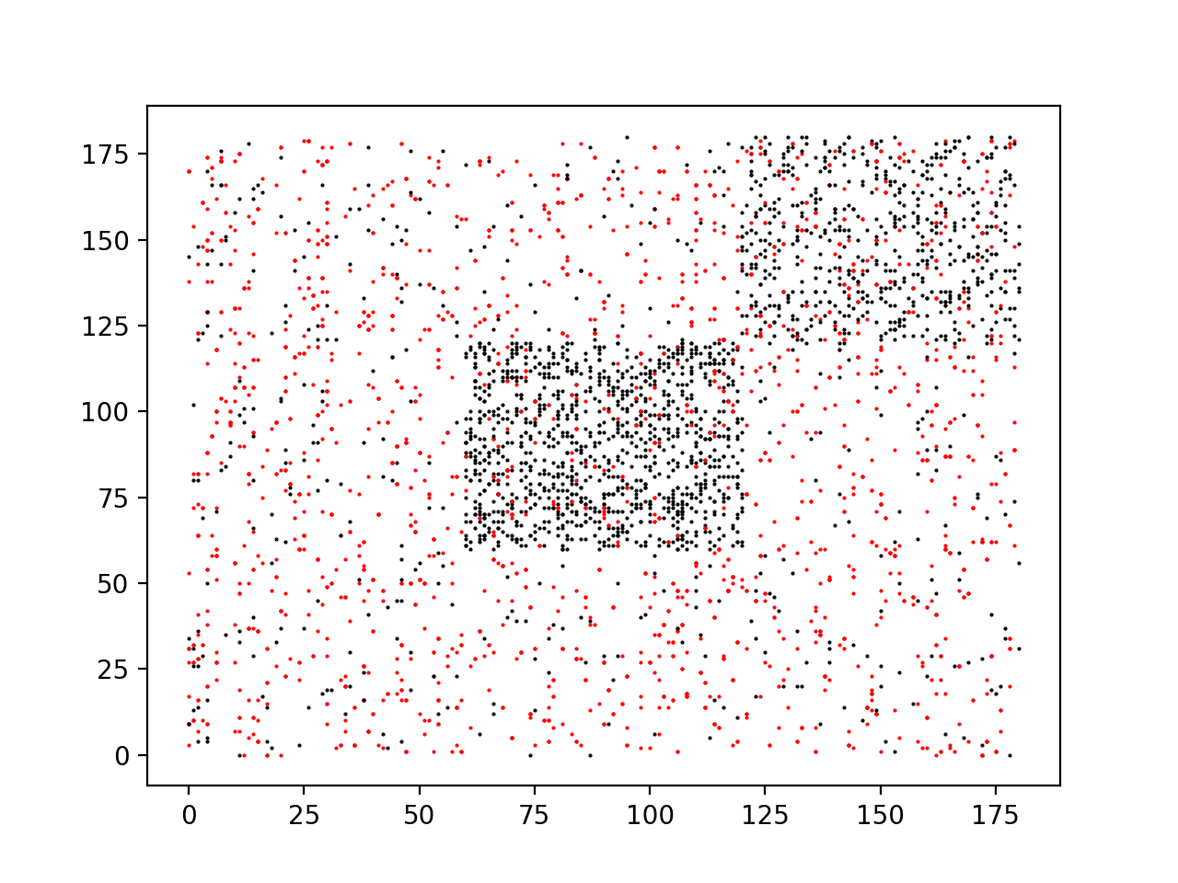
Pre-experiment Results
Time of step 0: 127.653s
Time of step 1: 3.200s
Number of iterations: 14 (with absolute error ε = 0.01)

Slide 5
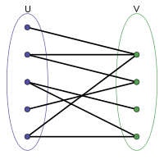
Bipartite Graph
Assumption:
If OD A was matched with OD B and OD B was matched with OD C in the past, we assume OD A has a relatively larger probability of being matched with OD C.

Slide 6
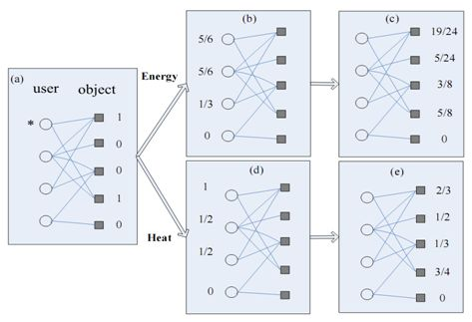
Algorithm
Initial value: C₀, from simulation data
Spread: C_{P} = W^{P}C₀

Slide 7
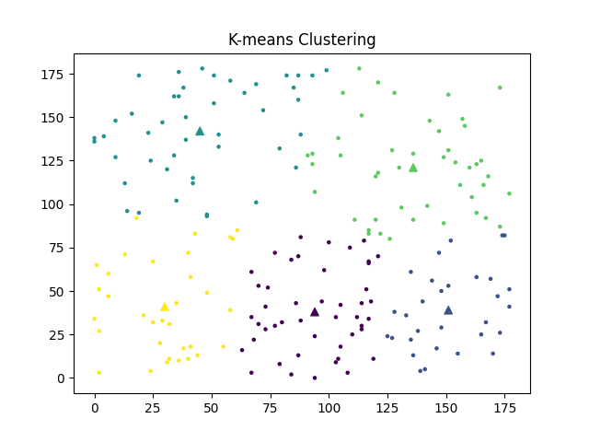
K-means Clustering
Initialize the center randomly for each cluster.
Assign each point to the nearest center.
Calculate the means of k clusters as its new center.
Turn to step 2.
k_means_clustering.py

Slide 8
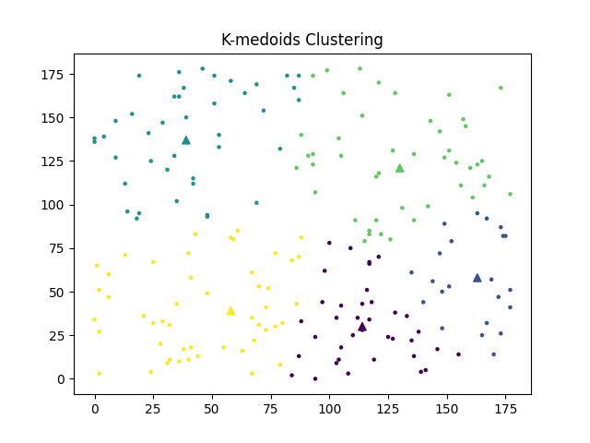
K-medoids Clustering
Initialize the center randomly for each cluster.
Assign each point to the nearest center.
Find an actual data point in each cluster that minimize the dissimilarity as the new center (say medoid).
Turn to step 2.
k_medoids_clustering.py

Slide 9
Advantages of K-medoids Clustering
Distance only needed.
Maybe we can define the distance between ODs with simulation results instead of using specific features.
Robust to noise.
Interpretability.

Slide 10
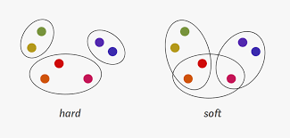
Type of Clustering
Broadly speaking, clustering can be divided into two subgroups:
Hard Clustering: In hard clustering, each data point either belongs to a cluster completely or not.
Soft Clustering: In soft clustering, instead of putting each data point into a separate cluster, a probability or likelihood of that data point to be in those clusters is assigned.

Slide 11
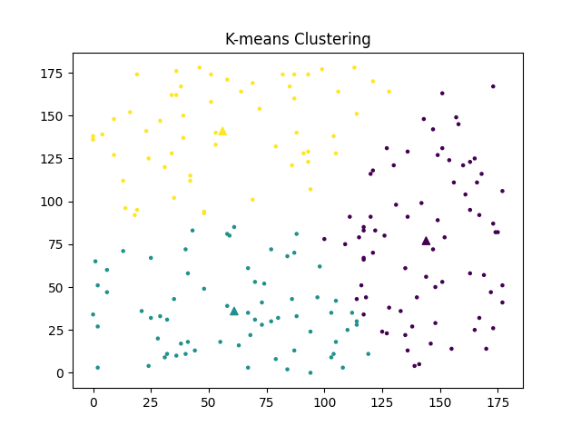
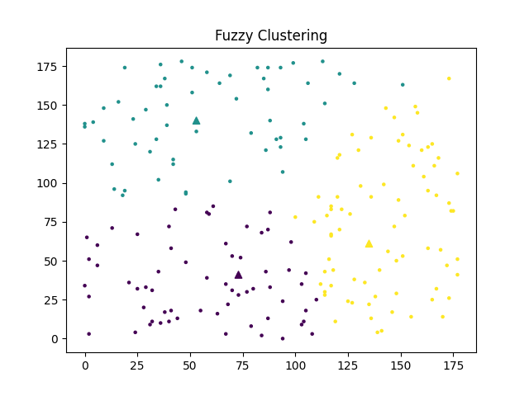
Fuzzy Clustering

Slide 12
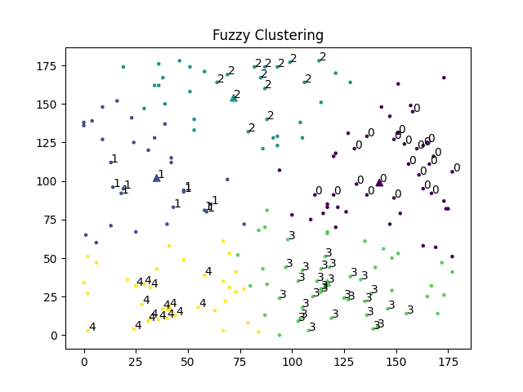
Fuzzy Clustering
A point is assigned to a cluster based on a probability.
Strategy of iteration is similar to K-means or K-medoids.
More parameters need to be determined by experiments.

Slide 13
K-medoids Clustering with Simulation Data
n[i][j] means number of times of matching between OD i and j.
Dummy distance[i][j] = max{n[i][j] | i ≠ j} – n[i][j] if i ≠ j and distance[i][j] = 0 if i = j.
Use the dummy distance to implement the K-medoids clustering.
Problems:
The matrix n[i][j] is very sparse.
Step 2 of K-medoids clustering: Assign each point to the nearest center.
In most cases, distance between one point to selected medoids is distance[i][j] = max{n[i][j] | i ≠ j}

